Slide 1
Clipping
Course Code: CSC 3224
Course Title: Computer Graphics
Dept. of Computer Science
Faculty of Science and Technology
Lecturer No: | 14 | Week No: | 11 | Semester:
Lecturer:

Slide 2
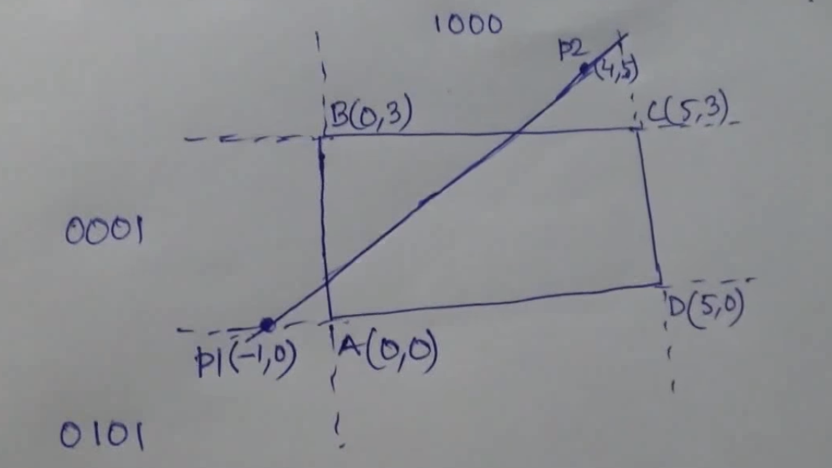
Problem Solving (Line Clipping)

Slide 3
Problem Solving (Line Clipping)

Slide 4
Problem Solving (Line Clipping)

Slide 5
Find Slope, m

Slide 6
Problem Solving (Line Clipping)

Slide 7
Find Y1ʹ

Slide 8
Problem Solving (Line Clipping)

Slide 9
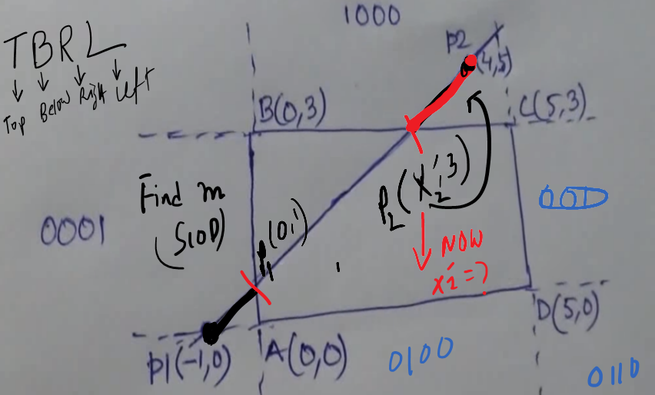
Find X2ʹ

Slide 10
Find X2ʹ

Slide 11
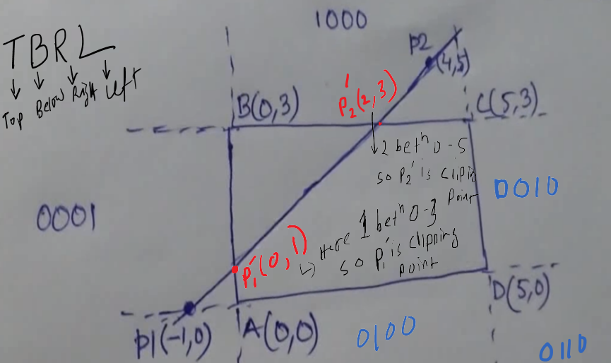
Finally

